Slide 1
IBM University Engagement Project Submission
“Exploring the Power of Agentic AI with IBM Granite and IBM Bob”

Slide 2

Project Tile – AI Lab Manual & Experiment Generator
Domain of Project – Education
Student Name | Recent Passport Photo | Email ID | Mobile number [WhatsApp]
Shreesha S
shreeshad78@gmail.com
8197463450

Slide 3
Problem Statement : AI Lab Manual & Experiment Generator
The Challenge
Students often struggle with creating structured lab manuals, understanding complex experiments, preparing for viva questions, and evaluating their practical work. Lab content is scattered across different resources, making it difficult to quickly obtain reliable, experiment-specific guidance. Traditional lab preparation also provides limited opportunities for interactive experimentation and personalized learning.
The Objective
Build an AI-powered Lab Assistant that helps students generate, understand, and practice computer science experiments. The solution should:
• AI Lab Manual Generation – Generate structured manuals with aim, theory, requirements, procedure, code, expected output, precautions, viva questions, and evaluation rubric.
• RAG Knowledge Retrieval – Retrieve relevant information from a curated laboratory knowledge base to provide more grounded and topic-specific responses.
• AI Learning Tutor – Allow students to ask questions and receive simplified explanations and guidance using IBM Granite.
• Interactive Virtual Lab – Provide hands-on simulations for algorithms such as K-Means Clustering and Binary Search with step-by-step execution.
• Automated Evaluation Support – Generate structured viva questions and 100-mark evaluation rubrics for practical assessment.
• IBM-Powered AI – Use IBM Granite 4 H Small through watsonx.ai with a secure backend architecture for AI inference.

Slide 4
Proposed Solution: AI-Powered LabGenie
The proposed solution is an AI-powered Lab Assistant built using IBM Bob, IBM watsonx.ai, and IBM Granite 4 H Small to simplify laboratory preparation, experimentation, and learning. The system addresses challenges in creating lab manuals, understanding technical concepts, preparing for viva questions, and gaining hands-on practice through an integrated learning platform.
At its core, the solution uses a Retrieval-Augmented Generation (RAG) pipeline to retrieve relevant information from a curated laboratory knowledge base covering subjects such as Data Structures, Python, DBMS, Operating Systems, Computer Networks, and Machine Learning. This context is provided to Granite models to generate more relevant and topic-specific content.
The system consists of three key components:
AI Lab Manual Generator creates structured experiment manuals containing the aim, theory, requirements, procedure, code, expected output, precautions, viva questions, and evaluation rubric based on the selected subject, topic, and difficulty level.
AI Learning Tutor allows students to ask questions about their experiment or topic and receive simplified explanations, concepts, use cases, complexity analysis, and learning guidance powered by IBM Granite and RAG.
Interactive Virtual Lab provides hands-on simulations for algorithms such as K-Means Clustering and Binary Search, allowing students to understand algorithmic steps through interactive experimentation.
The solution includes a user-friendly React dashboard that brings generation, AI tutoring, and virtual experiments together in a single platform. Students can generate manuals, download them, explore experiments, and interact with the AI tutor.
IBM Bob is used for development and project implementation, while IBM watsonx.ai provides the AI inference platform and Granite 4 H Small powers manual generation and intelligent tutoring. The lightweight RAG pipeline grounds responses using curated laboratory knowledge.
Overall, LabGenie AI delivers an end-to-end intelligent laboratory companion that helps students Generate → Experiment → Learn through AI-powered manuals, interactive simulations, grounded knowledge retrieval, and personalized learning support.

Slide 5
Technology Used
• IBM Bob Platform – Used for AI-assisted development, project implementation, and integration of the LabGenie AI application.
• IBM Granite 4 H Small – Used for natural language understanding, reasoning, lab manual generation, and AI-powered tutoring.
• IBM Cloud – Provides the secure and scalable cloud infrastructure required to connect and deploy the AI services.
• RAG (Retrieval-Augmented Generation) – Retrieves relevant information from the curated laboratory knowledge base first, then provides this context to Granite for more grounded and topic-specific responses.
• IBM watsonx.ai – Used for Granite model inference and AI service integration, enabling LabGenie to generate intelligent responses.
• Curated Knowledge Base – A collection of subject-specific Markdown resources covering Data Structures, Python, DBMS, Operating Systems, Computer Networks, and Machine Learning for RAG-based retrieval.
• React.js + Vite – Used to build the interactive and user-friendly frontend dashboard for lab generation, AI tutoring, and virtual experiments.
• Node.js + Express.js – Used to develop the backend APIs and securely handle communication between the frontend and IBM watsonx.ai.

Slide 6
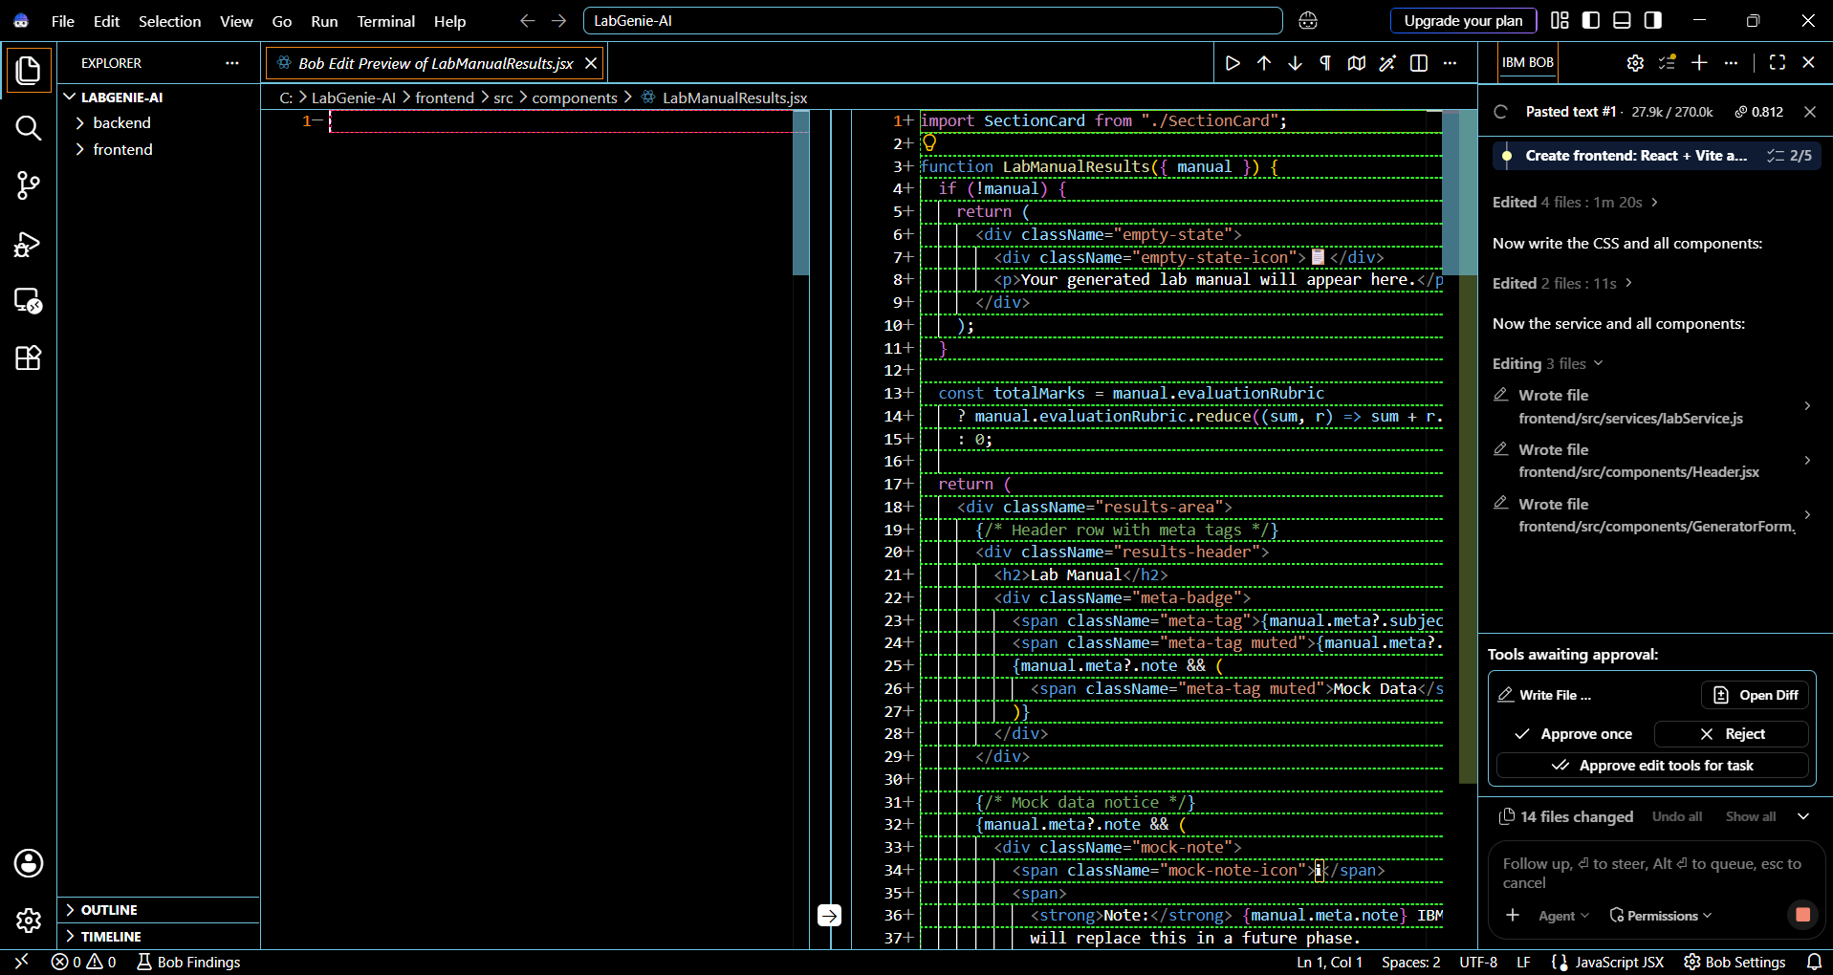
Required Files created using IBM bob -
App.jsx – Main React application component that manages navigation and connects the major features.
index.jsx / main.jsx – Entry point that initializes and renders the React application.
index.css – Contains the styling and responsive UI design for the LabGenie AI interface.
package.json – Defines the frontend and backend dependencies and project scripts.
.env – Stores IBM watsonx.ai configuration and API credentials securely.
index.js – Backend entry point that starts the Express server and configures API routes.
labController.js – Handles AI-powered lab manual generation using IBM Granite.
assistantController.js – Handles AI Tutor questions and Granite responses.
retriever.js – Implements the RAG-based retrieval system using the curated knowledge base.
labService.js – Connects the React frontend with the backend lab-generation API.
Knowledge Base Files (.md) – Subject-specific resources used by the RAG pipeline for grounded responses.

Slide 7
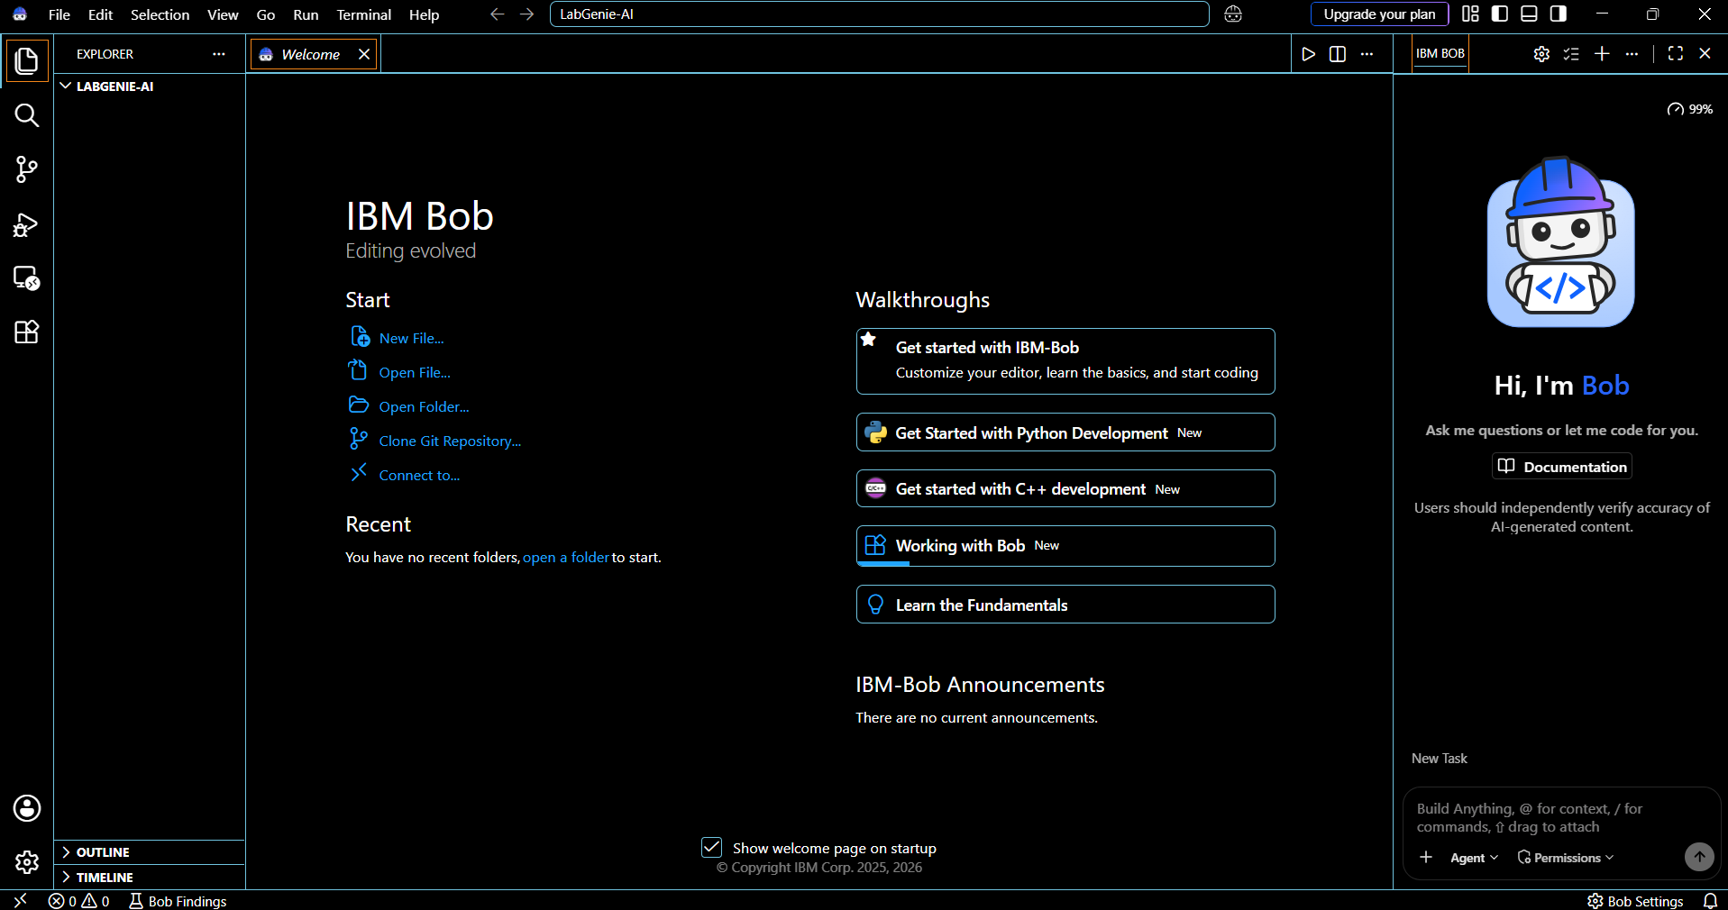
IBM Bob Screenshots:

Slide 8
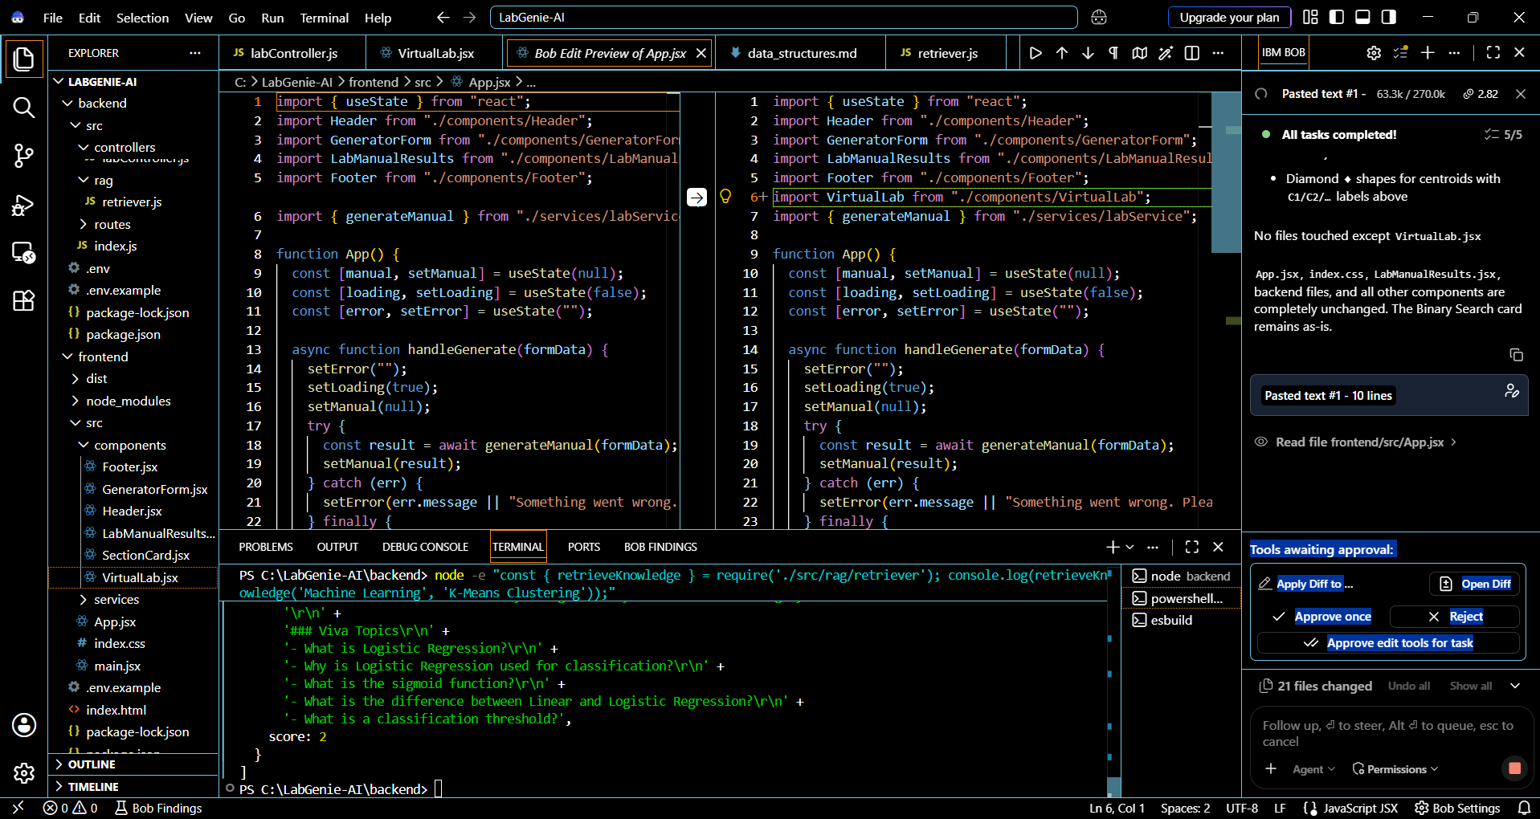

Slide 9
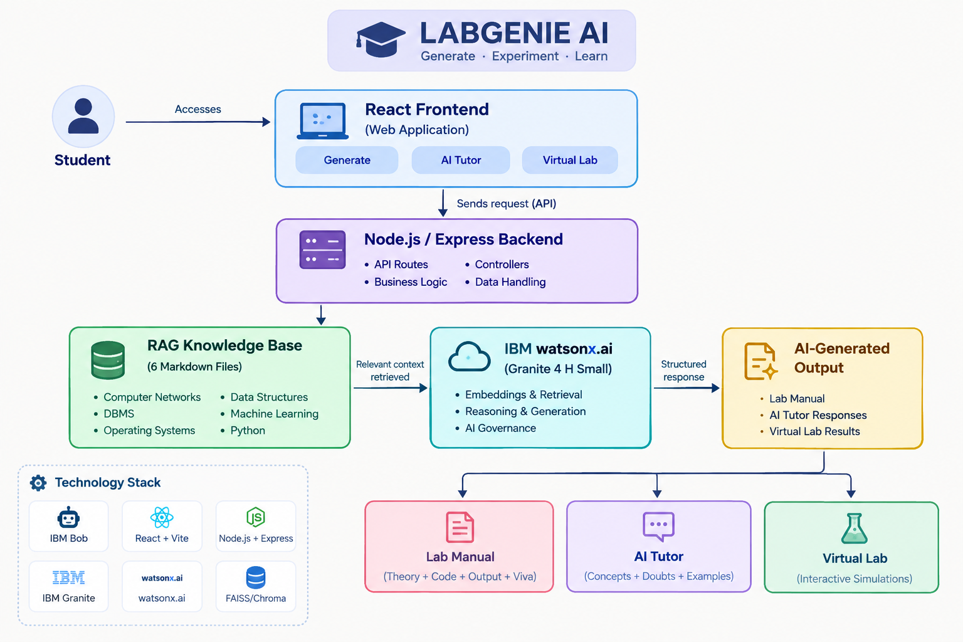
Architecture blueprint for IBM bob:

Slide 10

Role of Agentic AI in LabGenie AI
Agentic AI enables LabGenie AI to function as an intelligent learning assistant rather than a simple lab manual generator. Using IBM watsonx.ai and IBM Granite 4 H Small, the system coordinates different AI-powered capabilities to support laboratory preparation, experimentation, and learning.
The system performs specialized tasks such as generating structured lab manuals, retrieving relevant knowledge through RAG, answering student questions, and providing interactive algorithm simulations. This integrated approach enables students to move seamlessly between generating an experiment, understanding its concepts, and practicing it interactively.
Agentic AI also provides context awareness by using the selected subject, topic, and difficulty level to generate relevant laboratory content and explanations. Through RAG-based knowledge retrieval, the AI can use information from the curated laboratory knowledge base before generating responses.
Additionally, the system supports interactive and goal-oriented learning through the AI Tutor and Virtual Lab, allowing students to explore concepts, ask questions, and understand algorithms step-by-step.
Overall, Agentic AI makes LabGenie AI a smart digital laboratory companion that helps students Generate → Experiment → Learn using AI-powered guidance and interactive learning tools.

Slide 11
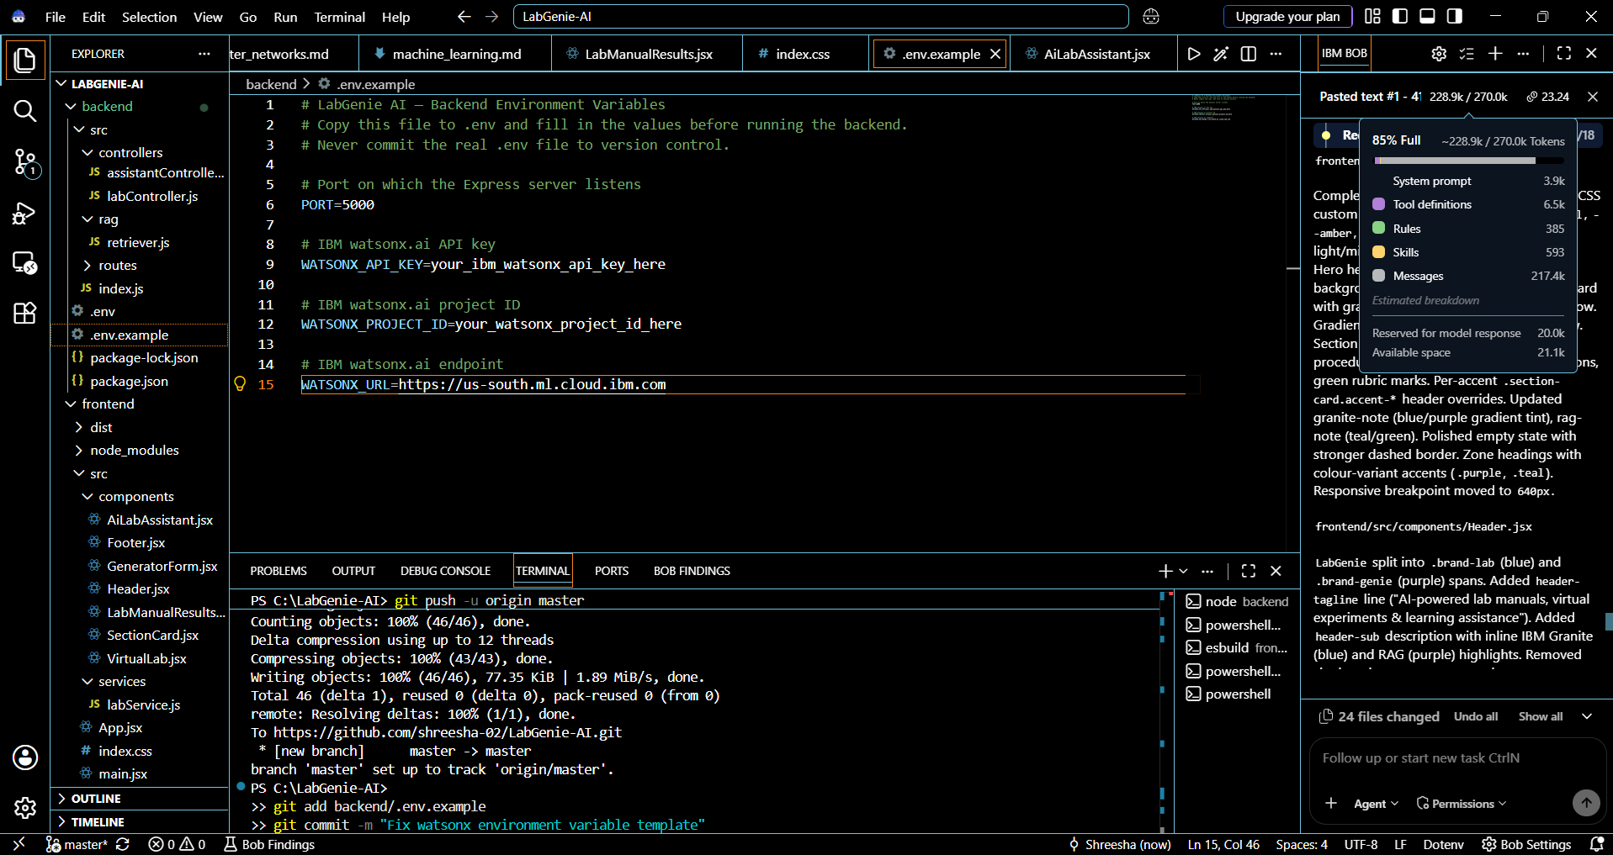
Token Usage
IBM Bob Token Usage
Current usage: 228.9k tokens
·
·
·

Slide 12
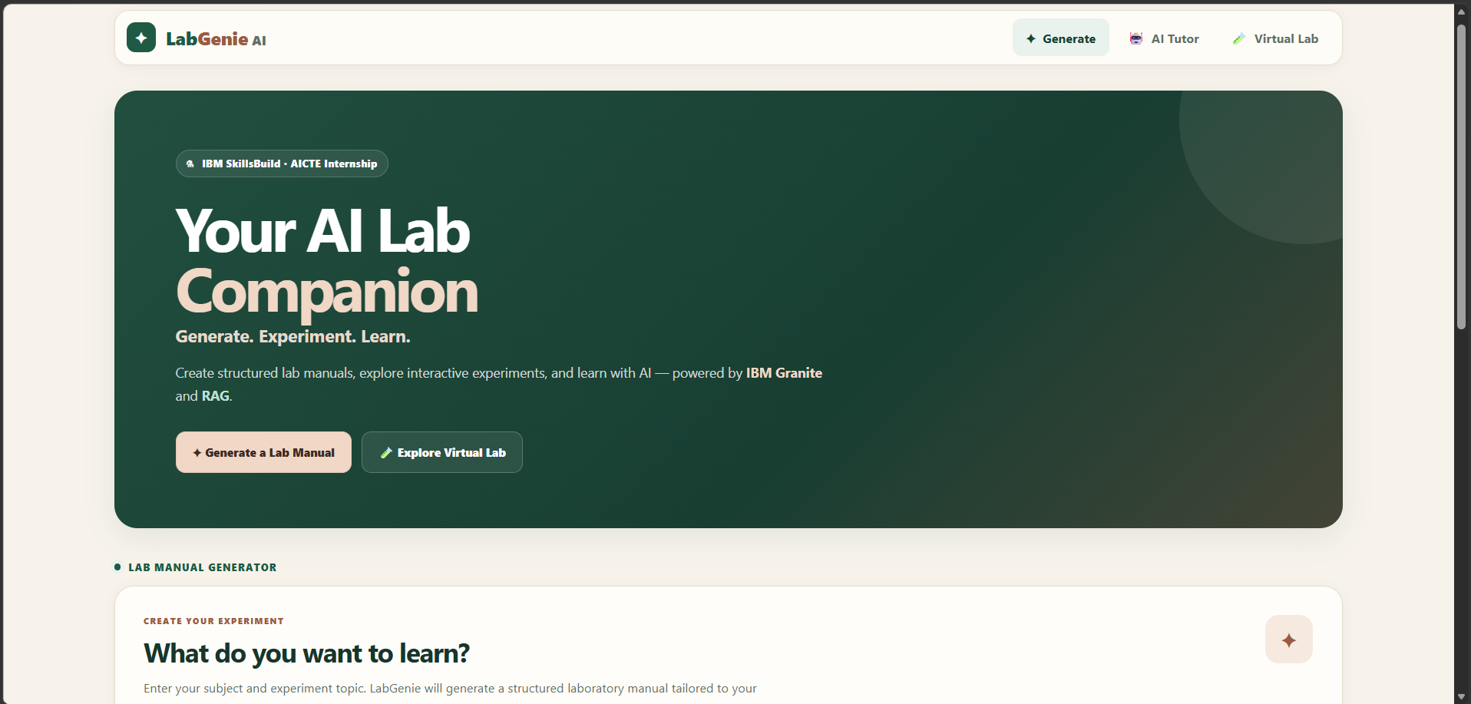
Project Output - LabGenie Home
·
·
·

Slide 13
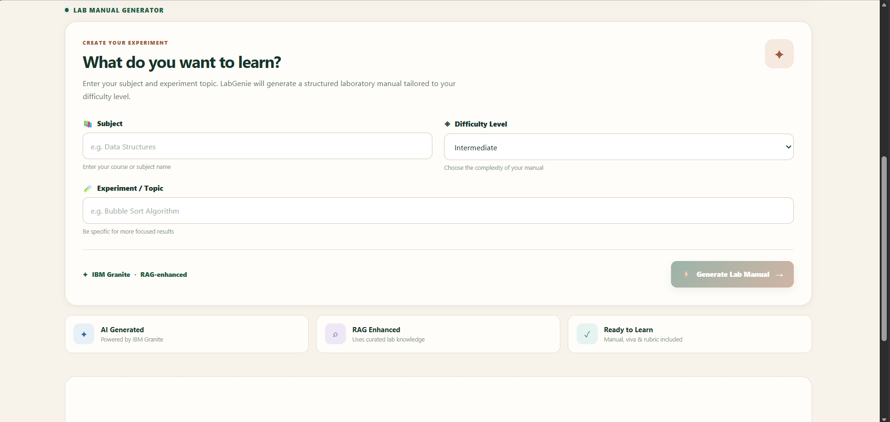
Project Output - AI-Generated Lab Manual
·
·
·

Slide 14
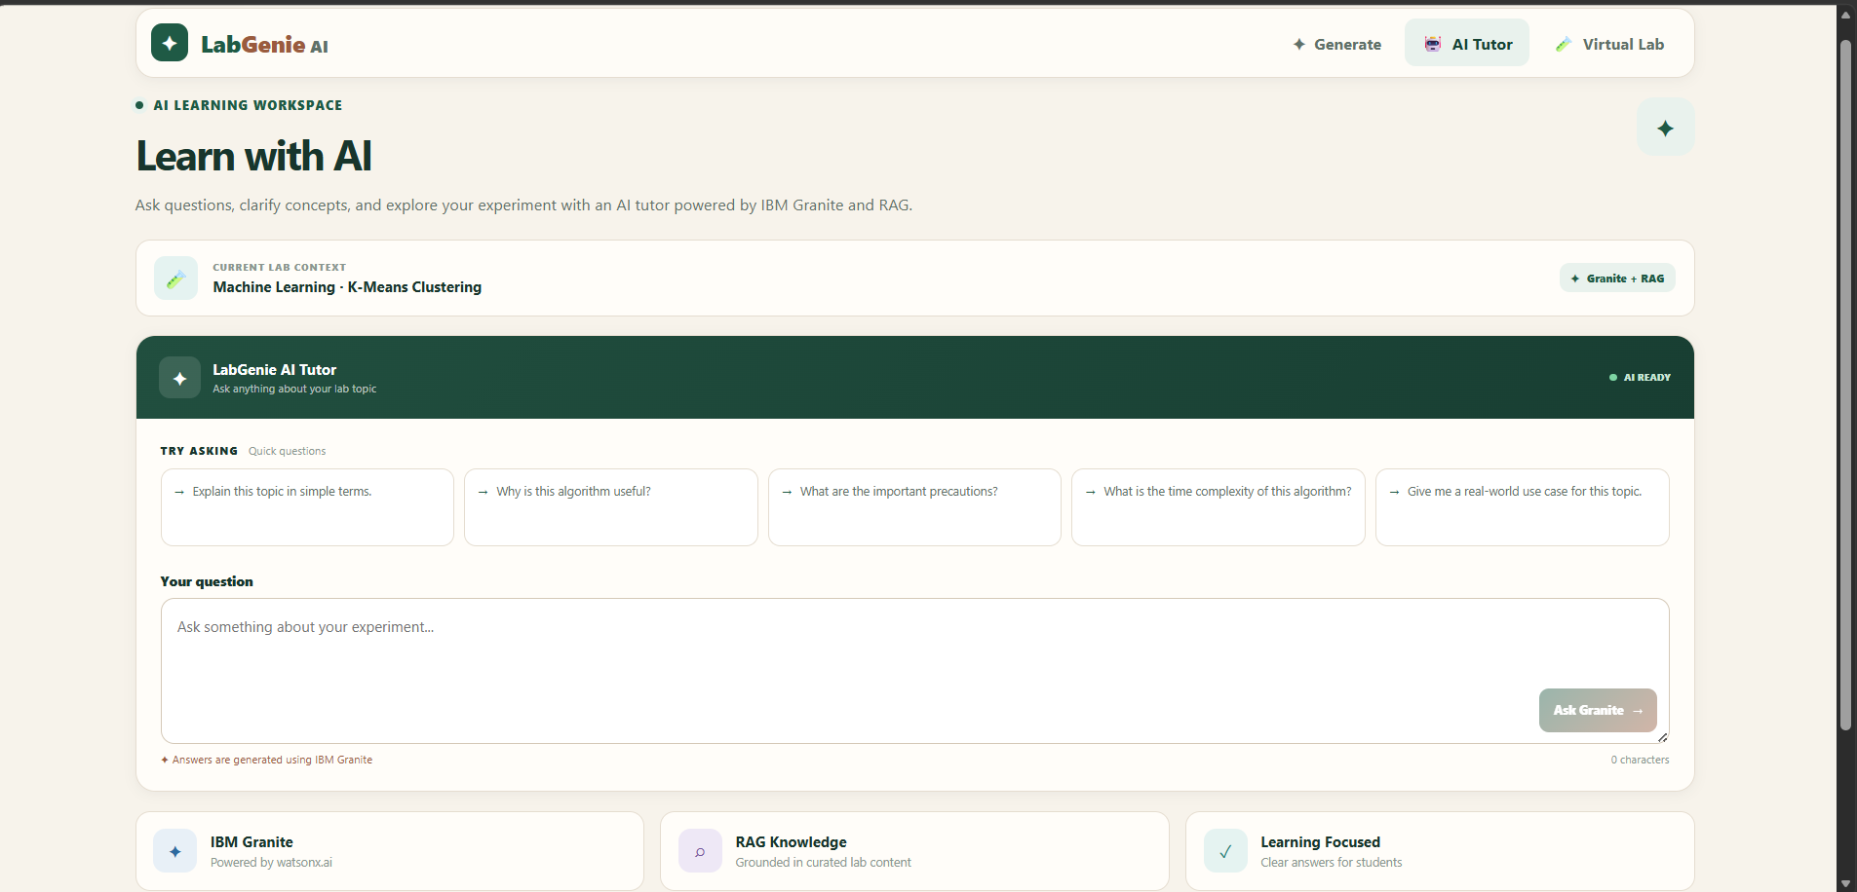
Project Output – AI Tutor
·
·
·

Slide 15
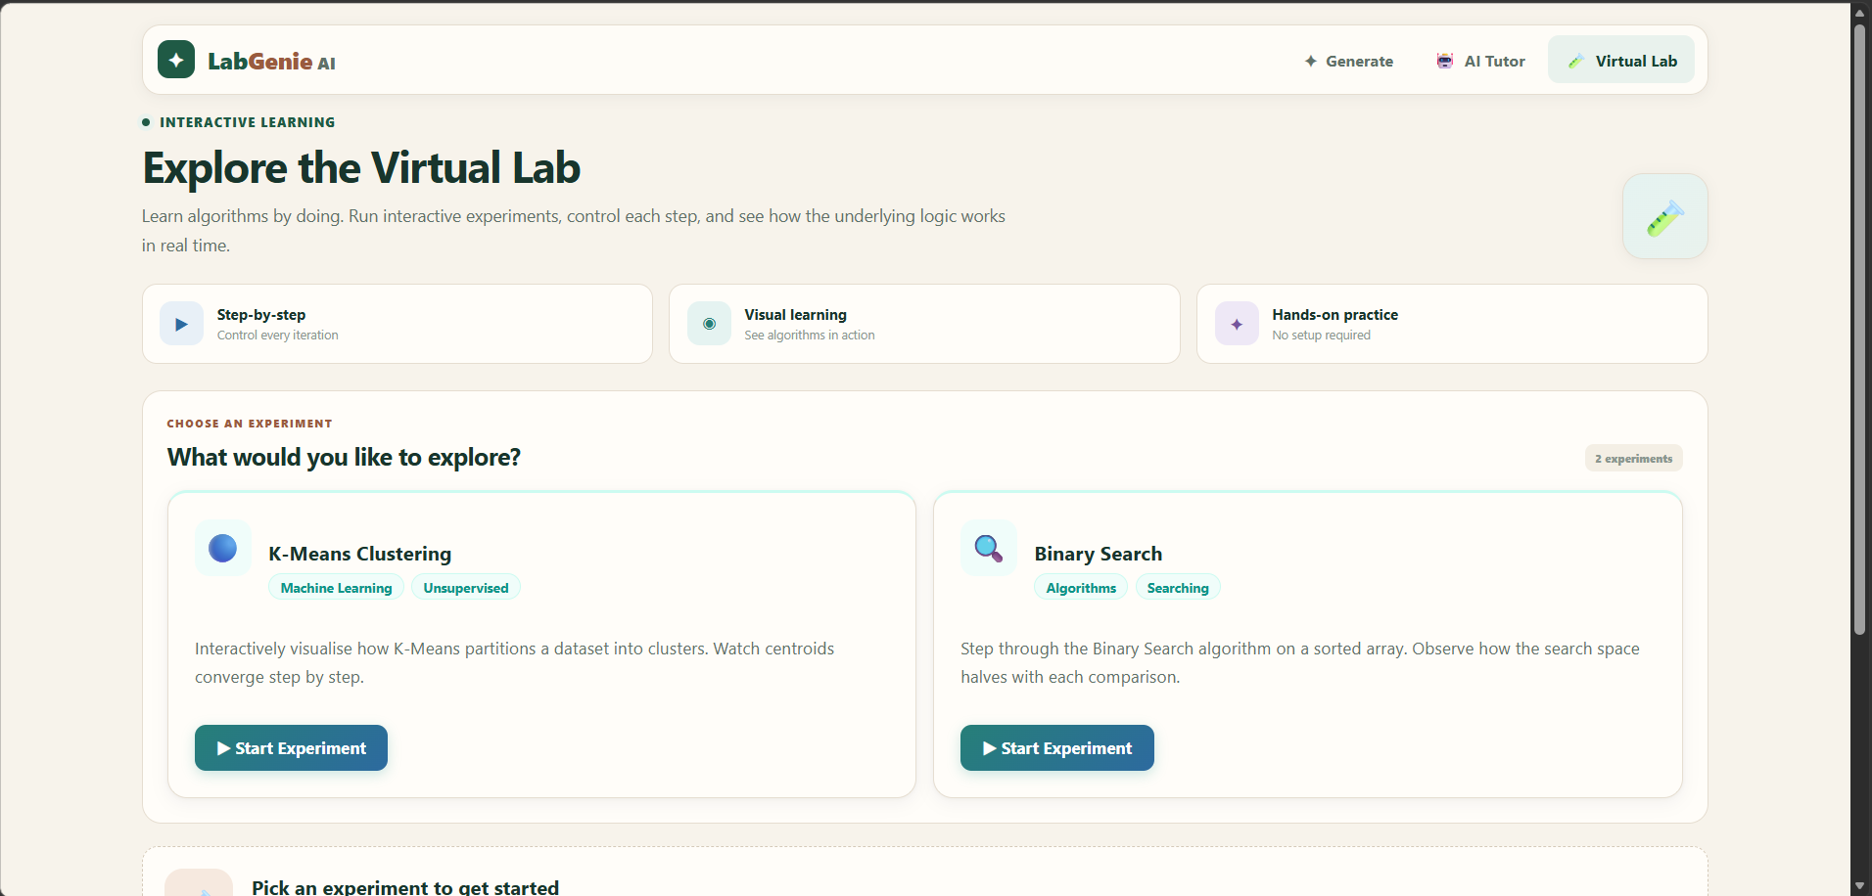
Project Output - Interactive Virtual Lab
·
·
·

Slide 16
Novelty and Uniqueness
LabGenie AI stands out by combining Generative AI, RAG, AI-powered tutoring, and interactive virtual experimentation into a single intelligent laboratory learning system.
AI-Powered Lab Generation – Automatically creates complete, structured lab manuals including theory, procedure, code, expected output, precautions, viva questions, and evaluation rubrics.
RAG-Based Grounding – Retrieves relevant information from a curated laboratory knowledge base before generating responses, making the content more topic-specific and reliable.
AI Learning Tutor – Goes beyond manual generation by allowing students to ask questions, get simplified explanations, understand complexity, and explore real-world applications.
Interactive Virtual Lab – Provides hands-on simulations for algorithms such as K-Means Clustering and Binary Search, helping students understand concepts through step-by-step experimentation.
Difficulty-Based Generation – Allows students to select Beginner, Intermediate, or Advanced difficulty levels for more suitable experiment content.
Automated Assessment Support – Generates viva questions and a structured 100-mark evaluation rubric, reducing the effort required for practical assessment.
Integrated Learning Platform – Combines Generate → Experiment → Learn in one user-friendly application instead of requiring students to use separate tools.
This makes LabGenie AI a smart, interactive, and AI-powered digital laboratory companion, rather than just a static lab manual generator.

Slide 17
Git Hub Link
GitHub Repository: https://github.com/shreesha-02/LabGenie-AI
·
·
·

Slide 18
Future Scope
Expansion to More Subjects & Experiments – The system can be expanded to support additional computer science subjects and a larger library of experiments. This will allow students to generate lab manuals and practice experiments across a wider range of academic topics.
Advanced AI Tutor & Voice-Based Learning – The AI Tutor can be enhanced with voice interaction, multilingual support, and more personalized explanations. This will make learning more accessible and allow students to interact naturally with the system.
Integration with Cloud-Based Virtual Labs – The Virtual Lab can be extended with more interactive simulations and real-time experiment execution, enabling students to practice algorithms and concepts in a more realistic laboratory environment.
Automated Performance & Assessment Tracking – Future versions can include student performance tracking, automated code evaluation, progress analytics, and personalized feedback, helping students identify their strengths and areas for improvement.
Enhanced RAG Knowledge Base – The knowledge base can be expanded with more curated resources, experiment references, and institutional lab content, improving the accuracy and relevance of AI-generated manuals and tutor responses.
·
·
·

Slide 19
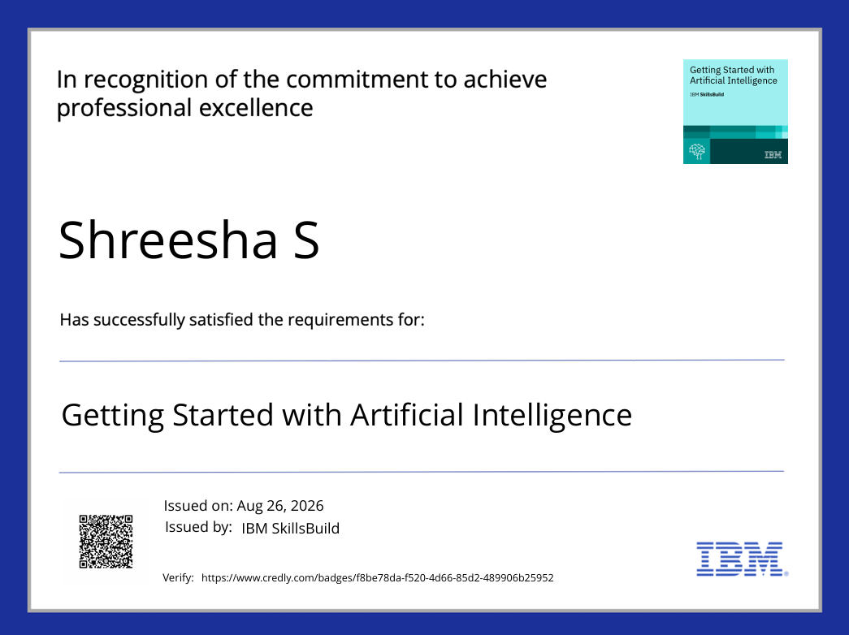
Certificates Earned:
Getting Started with Artificial Intelligence Certificate

Slide 20
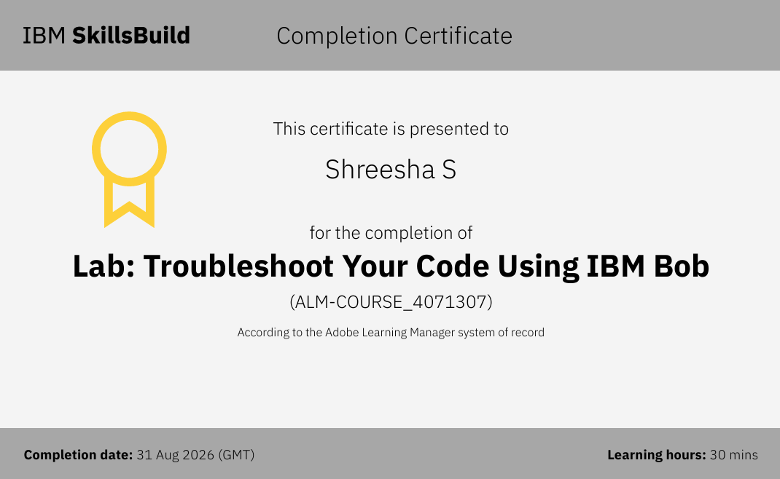
Certificates Earned:​
IBM BOB Certificate

Slide 21


